Slide 1
Social Media Sentiment Analysis on Stock Market
Group 18
Litao(John) Zhou
1006013092
Yuhan Zeng 1011218781
Zeying Zhou
1005172732
Applied Deep Learning Seminar – Winter 2025
Master of Enginnering in Electrical and Computer Engineering
Social Media Sentiment Analysis on Stock Market

Slide 2
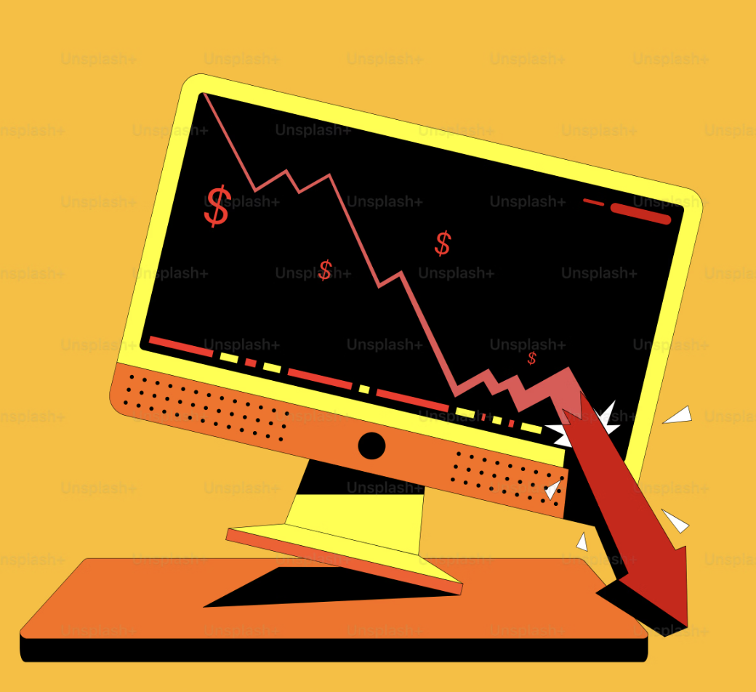
Background
Social media website such as X(formly known as Twitter) and Reddit contains real time reactions, emotions and opinions.
Investors, companies, and public users tend to express bullish, bearish or neutral attitude and opinions on the stock market .
Past stock price prediction methods depend on technical indicators and financial reports.
Social Media Sentiment Analysis on Stock Market

Slide 3




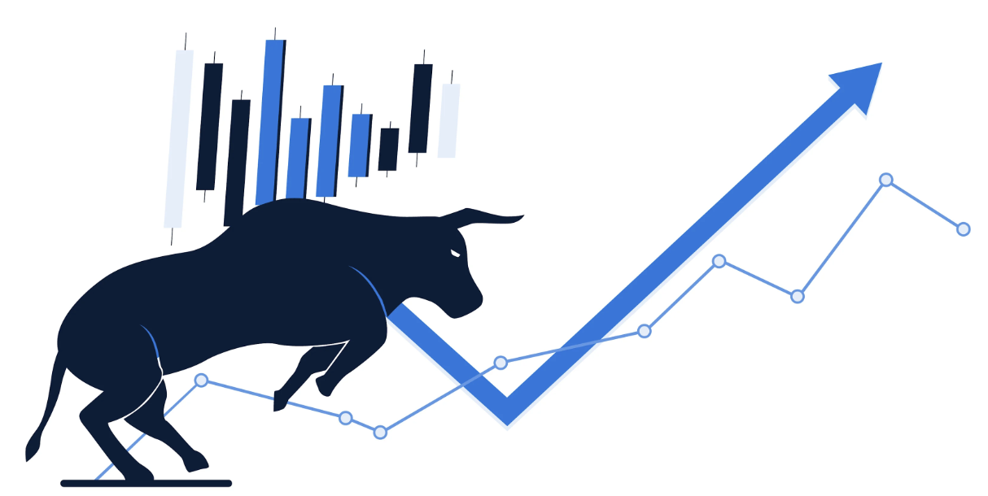

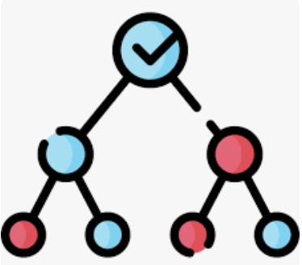



Methodology
Data Collection
Sentiment Analysis (FinBERT)
Apply fine-tuned Model
Prediction
Remark
zeroshot
1:
0:
-1:
Examples
Social Media Sentiment Analysis on Stock Market

Slide 4
Implementation & Result
financial-news twitters (~12000)
Labelled with bearish/bullish/neutral
Tesla-stock price (2021.09.30-2023.09.30)
Tesla related twitter
(2021.09.30-2023.09.30)
(~37k twitters)
twitter-cleaning mechanism
twitter-cleaning mechanism using regex
(URLs, hashtags, tickers, emojis, punctuation etc.)
Tesla relatedtwitter cleaned with sentiment analysis
Tokenize twitters
- Batch size: 16
- Epochs: 2
- Learning rate: 2e-5
- Weight decay: 0.01
Fine-tune FinancialBERT Model
(Test Accuracy:
~84%)
LSTM model
with 7 day look back window
(Test accuracy 65%）
Social Media Sentiment Analysis on Stock Market

Slide 5
Future Improvement
Variety | Predict model for different company
Practivity | Using real-time data for application (e.g. Fetch real-time info by using X API)
Model | Improve the fin-tuned parameters of FinBERT
Social Media Sentiment Analysis on Stock Market

